Slide 1



Preparation for Competitive Programming.
bit.do/DasproSE2019

Slide 2
WHAT IS COMPETITIVE
PROGRAMMING?

Slide 3

COMPETITIVE PROGRAMMING
MIND SPORT

Slide 4
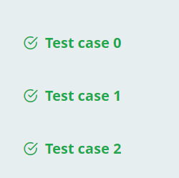
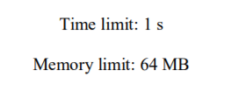
COMPETITIVE PROGRAMMING

Slide 5
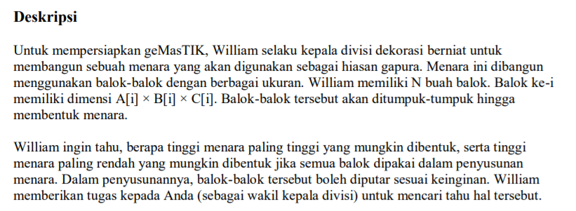
COMPETITIVE PROGRAMMING

Slide 6
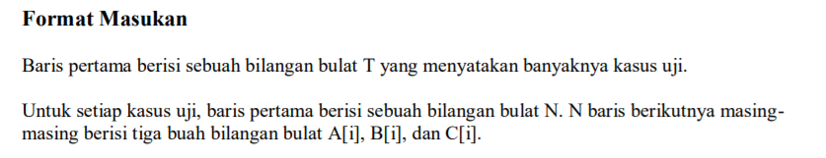
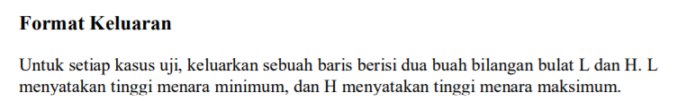
COMPETITIVE PROGRAMMING

Slide 7
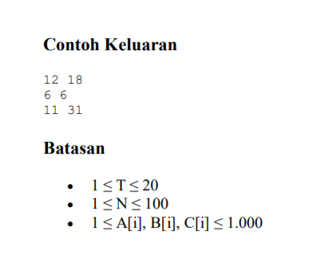
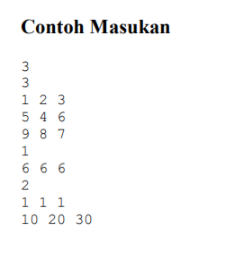
COMPETITIVE PROGRAMMING

Slide 8
BAHASA APA YANG DIPAKAI?

Slide 9


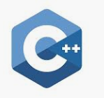
PROGRAMMING LANGUAGE

Slide 10
PROGRAMMING LANGUAGE

Slide 11


Why C++
Library

Slide 12
Java Vs C++

Slide 13


Java Vs C++

Slide 14


Java Vs C++
https://www.cprogramming.com/tutorial/java/syntax-differences-java-c++.html

Slide 15



COMPETITIVE PROGRAMMING
dan masih banyak lagi …

Slide 16
LET`S TRY
Bit.do/LatihanCP

